Slide 1
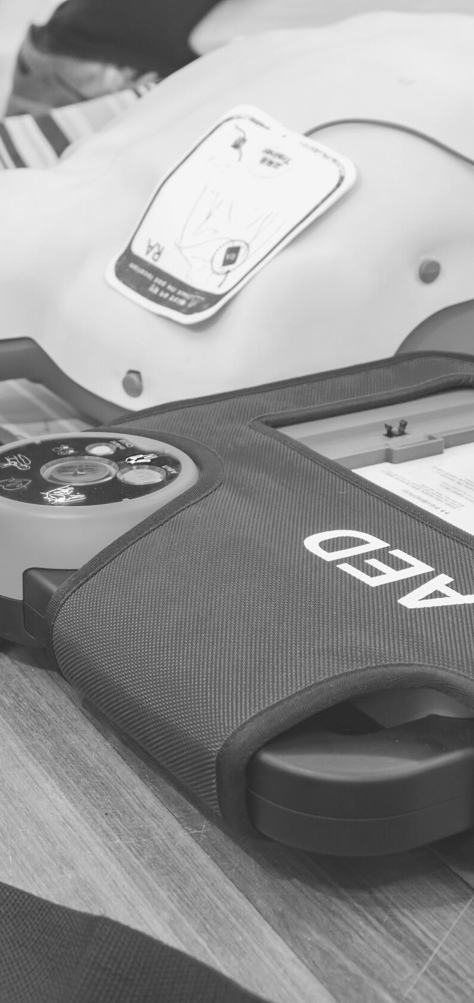
JOHN FURST
FIRSTAIDPOWERPOINT.ORG
INTRODUCTION TO FIRST AID

Slide 2
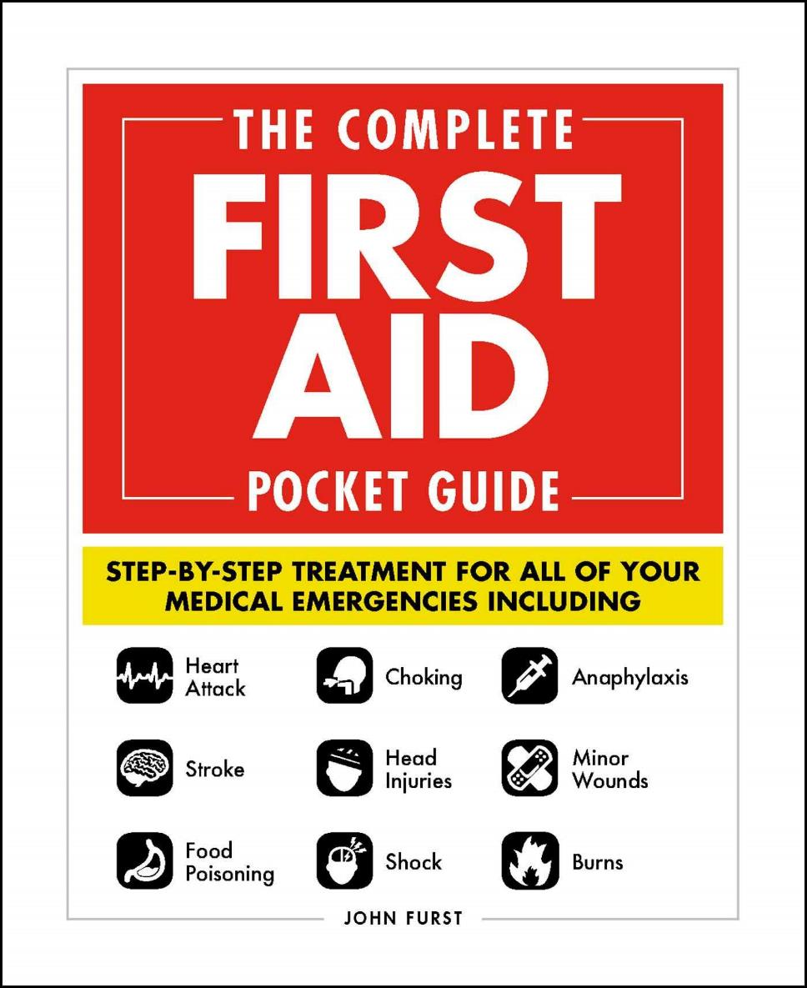

JOHN FURST
FIRSTAIDPOWERPOINT.ORG
From minor cuts and burns, to heart attacks and strokes, this handy, take-anywhere guide gives you the knowledge and advice you need to recognize and respond to any medical emergency.
Be prepared for any medical emergency and handle it safely and efficiently with The Complete First Aid Pocket Guide. Quickly identify signs and symptoms of a wide range of medical conditions and learn how to recognize the difference between a minor injury or illness, and those that are more serious with this essential handbook.

Slide 3

The Definition of First Aid
“Help given to a sick or injured person until full medical treatment is available”
“…provision of initial care for an illness or injury”
FIRSTAIDPOWERPOINT.ORG

Slide 4
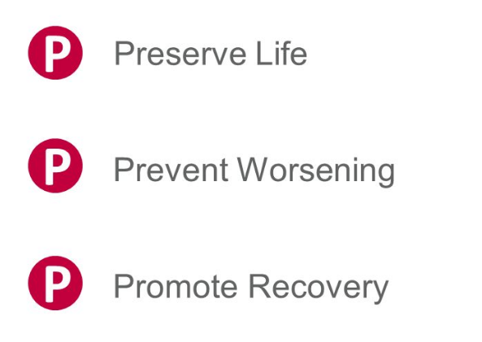
The Aims of First Aid
Broadly, there are three main aims when administering first aid:
  Preserve life
  Prevent worsening of the condition (if possible)
  Promote recovery
For example, applying a plaster is preventing the condition (a cut) from worsening by stopping infection.
These aims are known as the ‘three Ps’ of first aid
FIRSTAIDPOWERPOINT.ORG

Slide 5
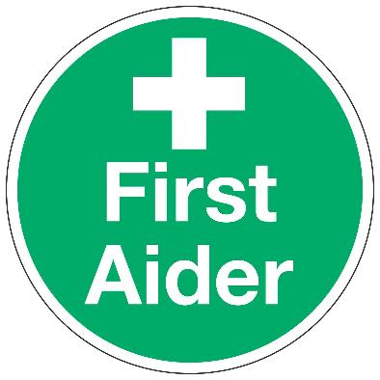
Roles and Responsibilities of a First Aider
A first aider has various roles and responsibilities. They should:
Manage the incident and ensure the continuing safety of themselves, bystanders and the patient
Assess victims and find out the nature & cause of their injuries
Arrange for further medical help or other emergency services to attend
If trained, prioritise casualties based upon medical need
Provide appropriate first aid treatment as trained
If able, make notes/observations of casualties
Fill out any paperwork as required
Provide a handover when further medical help arrives
FIRSTAIDPOWERPOINT.ORG

Slide 6
Calling for Emergency Help
In many first aid situations, help from the emergency services will be required.
Ensure you know the best emergency service number to use.
  United Kingdom: 999
  United States: 911
  European Union: 112
  Other countries: https://en.wikipedia.org/wiki/List_of_emergency_telephone_numbers
FIRSTAIDPOWERPOINT.ORG

Slide 7
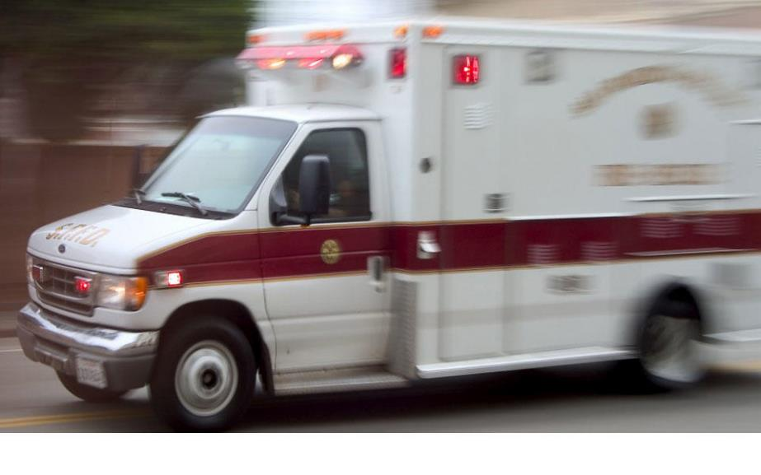
Calling for Emergency Help
Give clear, precise information about
  The exact location of the incident and any access problems
  The number of casualties / people involved
  The nature of their injuries
  The age of the victims
  Any hazards at the incident (e.g: spilt fuel, fire, electricity)
If the area is remote or difficult to access, consider sending someone to meet the emergency services.
FIRSTAIDPOWERPOINT.ORG

Slide 8
Incident Management
Always conduct a risk assessment before rushing into any situation. Look for any potential hazards to yourself, bystanders or the patient (e.g: moving traffic, fire & smoke, electricity). Never put yourself or other bystanders in danger.
Remember, YOU are the most important person
If the incident is too dangerous to approach, stay back and await the arrival of the emergency services.
FIRSTAIDPOWERPOINT.ORG

Slide 9
Incident Management
Think about the photo on the next slide (either individually or in groups)
Take a few minutes to discuss:
1) How would you manage this incident?
2) What dangers are present or could be present?
3) What should your first action be?
FIRSTAIDPOWERPOINT.ORG

Slide 10
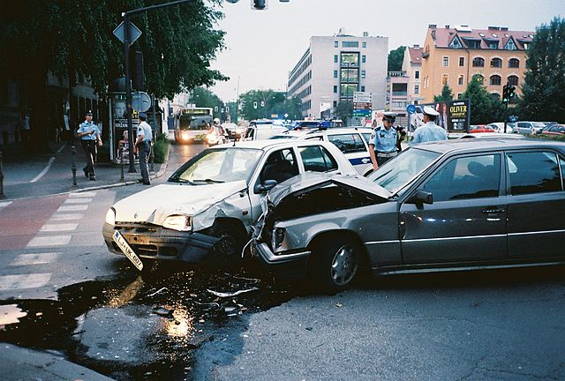
Incident Management
FIRSTAIDPOWERPOINT.ORG

Slide 11
Incident Management
Potential hazards in this situation:
Moving vehicles
Oil or fuel spillage
Broken glass
Undeployed airbags
Risk of fire or explosion
FIRSTAIDPOWERPOINT.ORG

Slide 12
Infection Control
Various diseases can be transmitted via blood and body fluids (for example HIV and Hepatitis B & C)
If possible, always wear disposable gloves when dealing with bodily fluids
  HOWEVER: This is not always practical! In an emergency situation you can improvise and use anything to create a barrier. e.g: a plastic carrier bag
Ensure any cuts/open injuries to your hands are covered with waterproof plasters or dressings.
Wash your hands with soap and running warm water whenever possible
FIRSTAIDPOWERPOINT.ORG

Slide 13
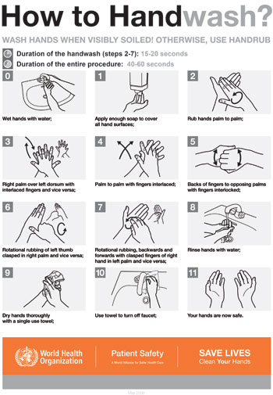
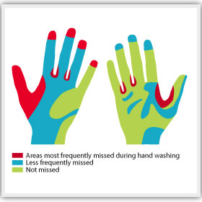
Infection Control
Effective handwashing is vital to reduce the risk of transmitting infection
FIRSTAIDPOWERPOINT.ORG

Slide 14
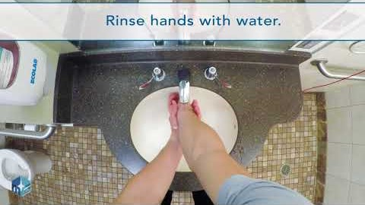
Hand Hygiene Video
FIRSTAIDPOWERPOINT.ORG
Notes:
https://www.youtube.com/watch?v=17NgFQODrvQ

