Slide 1
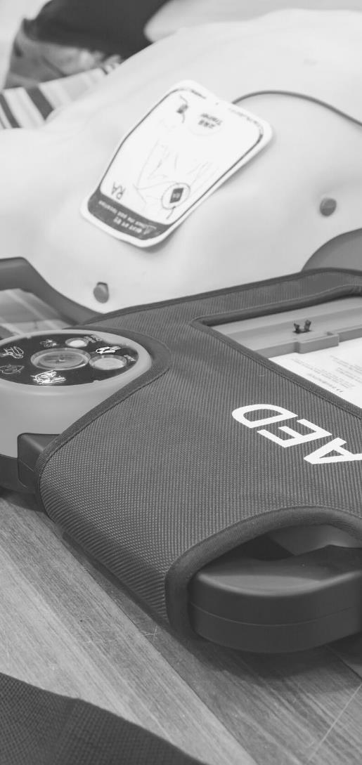
JOHN FURST
FIRSTAIDPOWERPOINT.ORG
Asthma

Slide 2
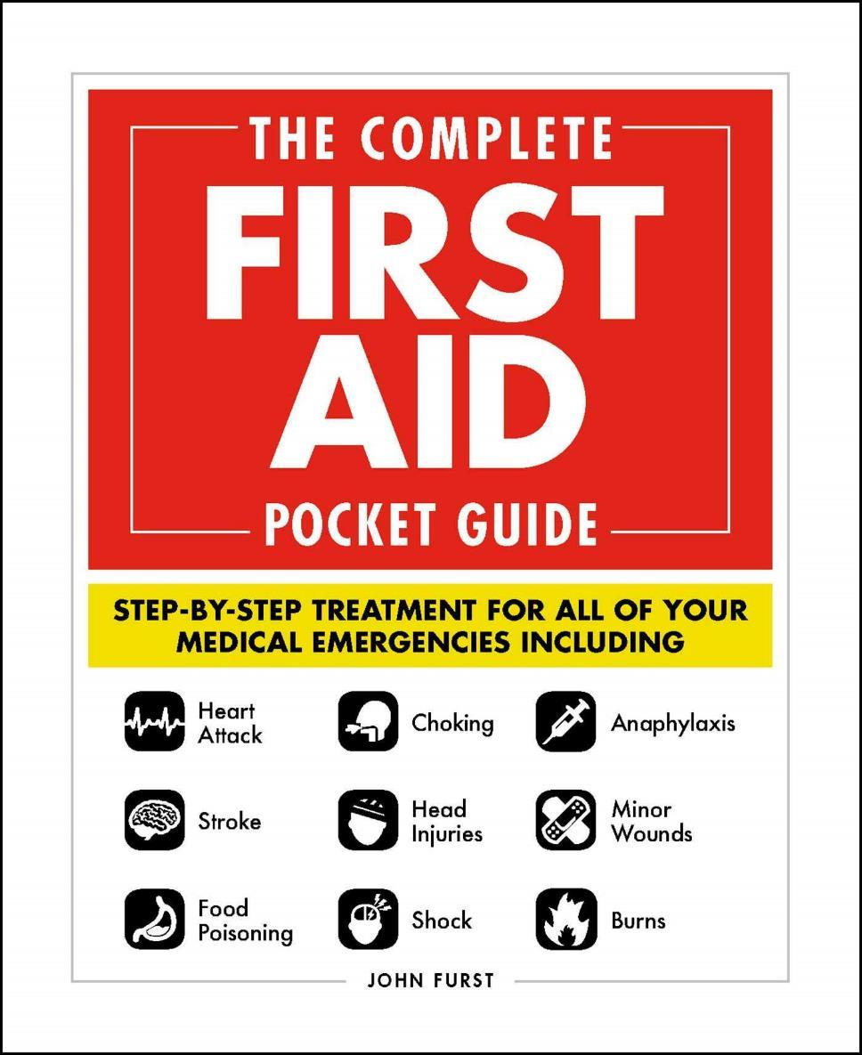

JOHN FURST
FIRSTAIDPOWERPOINT.ORG
From minor cuts and burns, to heart attacks and strokes, this handy, take-anywhere guide gives you the knowledge and advice you need to recognize and respond to any medical emergency.
Be prepared for any medical emergency and handle it safely and efficiently with The Complete First Aid Pocket Guide. Quickly identify signs and symptoms of a wide range of medical conditions and learn how to recognize the difference between a minor injury or illness, and those that are more serious with this essential handbook.

Slide 3
What is Asthma?
Asthma is an inflammatory condition of the small airways in the lung.
These small air tubes can become inflamed and secrete excessive amounts of mucous causing severe difficulty in breathing. This is known as an asthma attack. The cause of asthma is thought to be a combination of environmental and genetic factors
Asthma is very common. Asthma affects approximately 300 million individuals worldwide. Unfortunately, Asthma is still a deadly disease. Around 250,000 people die a year due to complications from Asthma.
FIRSTAIDPOWERPOINT.ORG

Slide 4
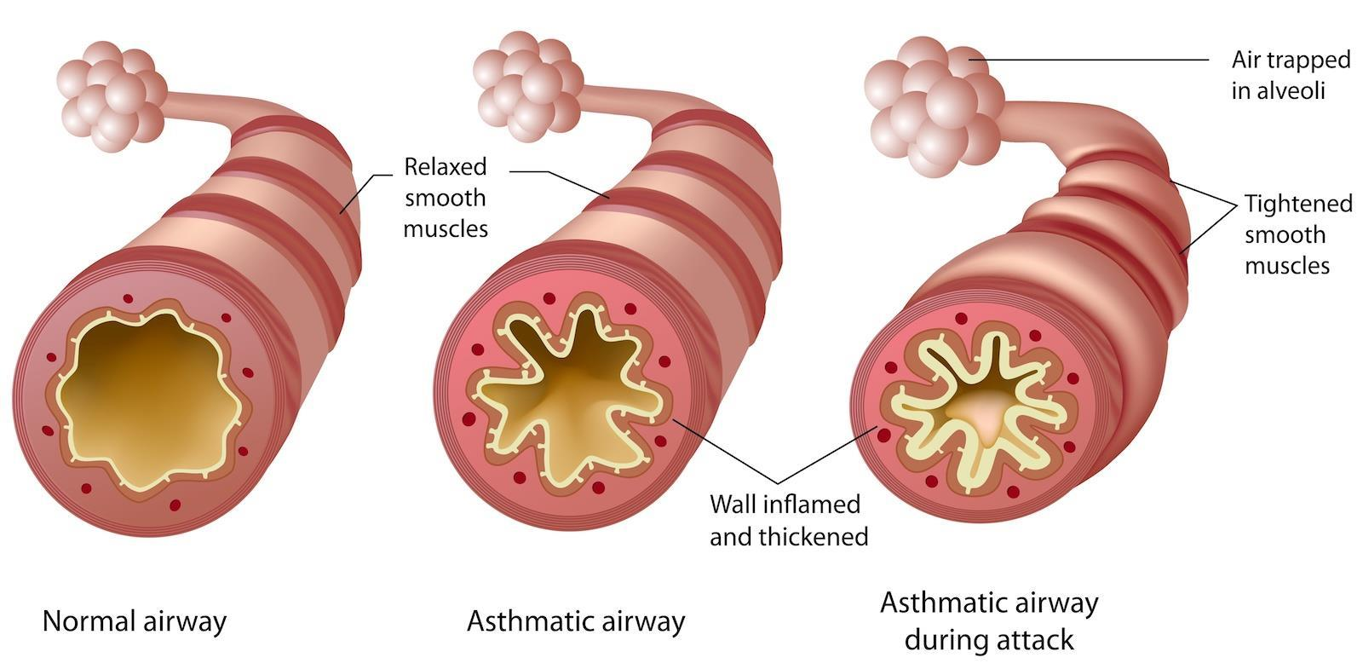
What is Asthma?
FIRSTAIDPOWERPOINT.ORG

Slide 5
Signs and Symptoms
An asthma attack is normally triggered by something, whether it be an allergen (e.g: pollen, dust, vehicle emissions, soot etc.) or an environmental condition such as cold air. Normally, an asthma attack is characterized by the following symptoms:
A ‘wheezing’ sound when breathing
Difficulty in breathing
Unable to complete a full sentence
Hyperventilation
Anxiety and panic
Reducing levels of consciousness
FIRSTAIDPOWERPOINT.ORG

Slide 6
First Aid Management
Sit the patient down in the position they find most comfortable for their breathing.
Find their medication, which is normally an inhaler (possibly with a spacer device) containing a drug such as Salbutamol.
Assist the victim to use their medication. They should know how many doses to take and how to use the inhaler.
Provide reassurance and help calm the person’s breathing if they are hyperventilating.
If the medication does not have any effect, the patient starts to become drowsy/exhausted or if they have forgotten their medication then you should call an emergency ambulance immediately.
If in doubt – call for emergency medical help
FIRSTAIDPOWERPOINT.ORG

Slide 7
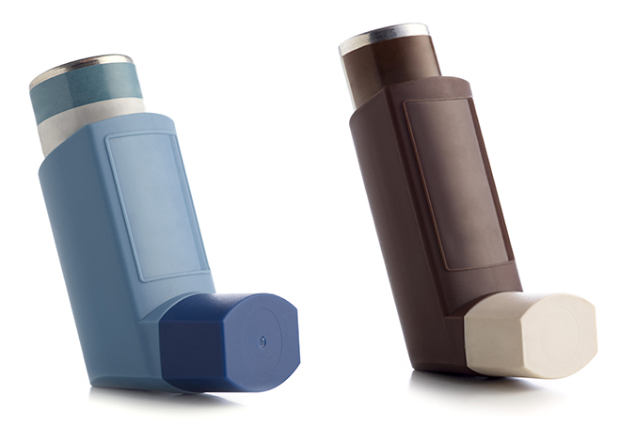
Medication for Asthma
There are two main types of inhalers used for asthma.
  Relievers – these help in an acute attack
  Preventers – this medication is taken daily to reduce asthma symptoms and the risk of asthma attacks
In an emergency situation, reliever inhalers should be used. These contain drugs such as Salbutamol (Ventolin) which open up the small airways in the lungs.
Reliever inhalers are often blue, however this will vary depending on the drug manufacturer
FIRSTAIDPOWERPOINT.ORG

Slide 8
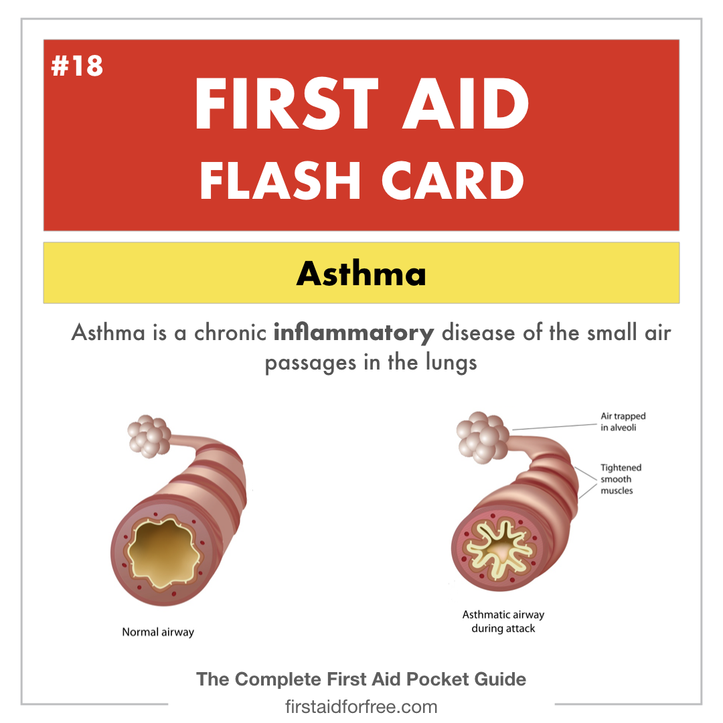
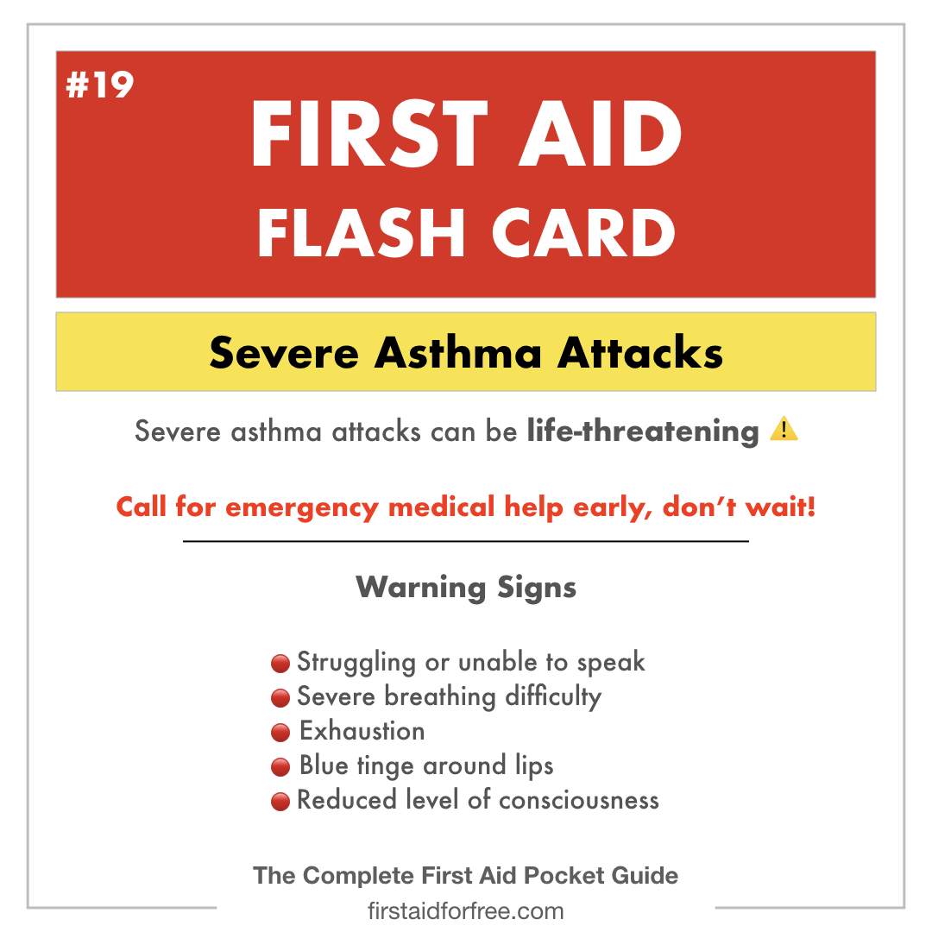
First Aid Flash Cards
FIRSTAIDPOWERPOINT.ORG

