Slide 1
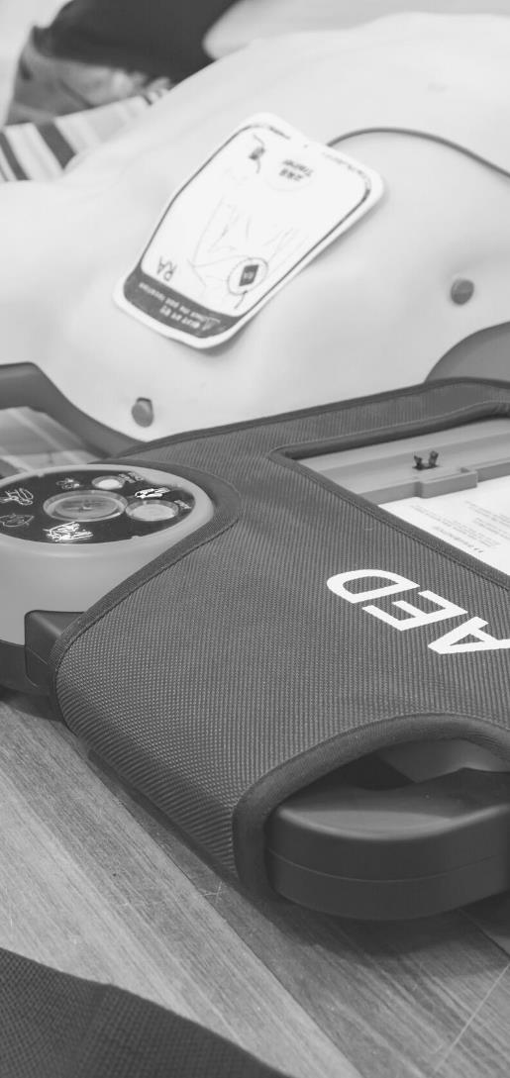
JOHN FURST
FIRSTAIDPOWERPOINT.ORG
Heart Attack

Slide 2
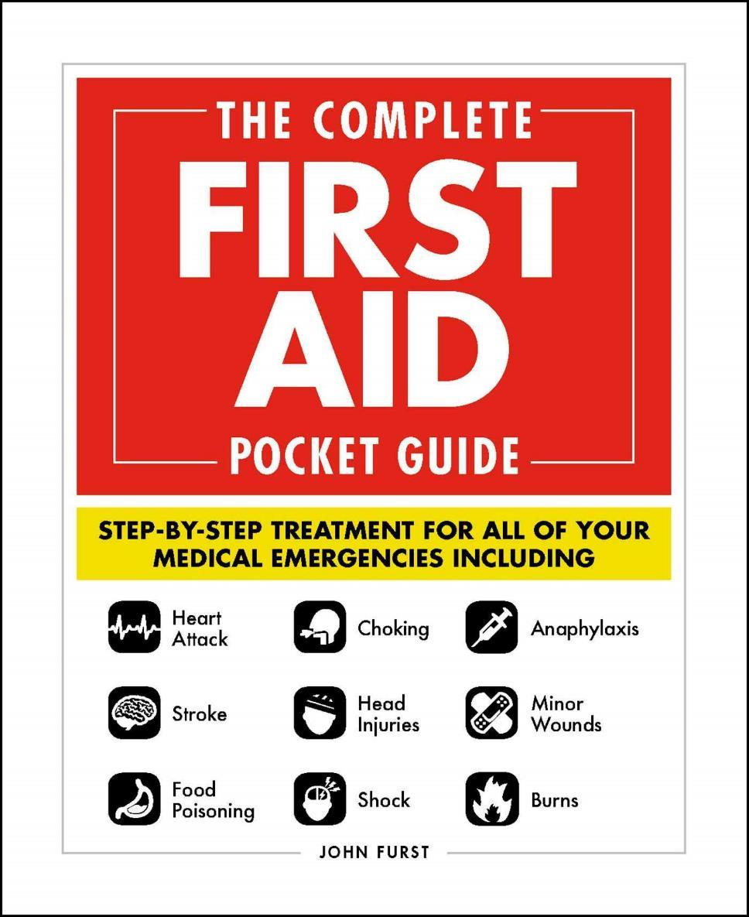

JOHN FURST
FIRSTAIDPOWERPOINT.ORG
From minor cuts and burns, to heart attacks and strokes, this handy, take-anywhere guide gives you the knowledge and advice you need to recognize and respond to any medical emergency.
Be prepared for any medical emergency and handle it safely and efficiently with The Complete First Aid Pocket Guide. Quickly identify signs and symptoms of a wide range of medical conditions and learn how to recognize the difference between a minor injury or illness, and those that are more serious with this essential handbook.

Slide 3
What is a Heart Attack?
The heart is a pump made of muscle. It pumps blood around our body as part of the circulatory system. The heart requires a constant supply of blood itself in order to pump effectively.
The heart is supplied with blood by a network of coronary arteries.
These arteries can become blocked with clots or fatty tissue. This is a process known as atherosclerosis and causes ischemic heart disease (IHD).
When the coronary arteries become blocked, the heart muscle does not receive enough oxygen/nutrients and dies.
This is known as a heart attack.
FIRSTAIDPOWERPOINT.ORG

Slide 4
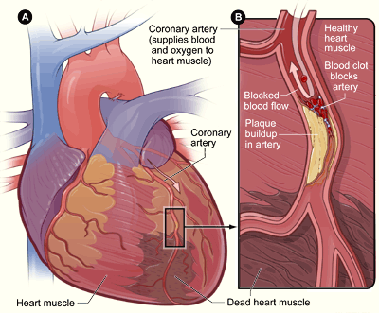
What is a Heart Attack?
The medical term for a heart attack is Myocardial Infarction (MI)
FIRSTAIDPOWERPOINT.ORG

Slide 5
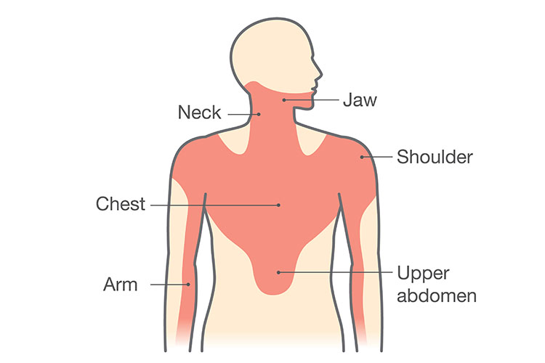
Signs and Symptoms
Chest pain (which does not get better)
  May spread to jaw / shoulders / arm / back
Shortness of breath
Victim becomes pale / sweaty
Fear and anxiety (“sense of impending doom”)
Irregular pulse
Feeling sick (nausea) and vomitting
FIRSTAIDPOWERPOINT.ORG

Slide 6
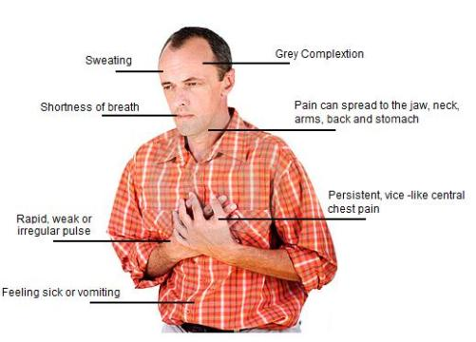
Signs and Symptoms
FIRSTAIDPOWERPOINT.ORG

Slide 7
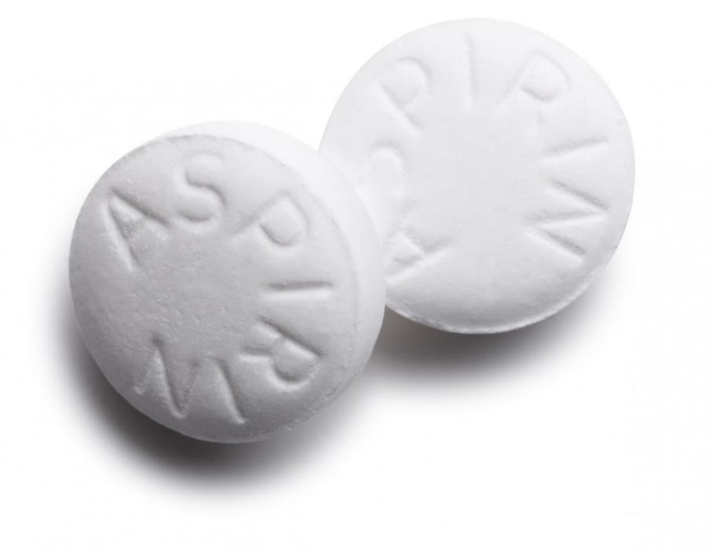
First Aid Management
Call for emergency medical help
Encourage the patient to chew a large (300mg) Aspirin unless they are allergic
Place the victim in a position of rest, ideally on the floor
Monitor and give reassurance whilst waiting for ambulance
Be prepared to give Cardiopulmonary Resuscitation
FIRSTAIDPOWERPOINT.ORG

Slide 8
Aspirin
Aspirin helps by breaking down clots which cause heart attacks. It is not given for pain relief in this emergency situation.
You should encourage the casualty to chew a 300mg (large) aspirin so that it is absorbed through the mouth and gums.
They should not swallow the Aspirin as this will not be as effective.
FIRSTAIDPOWERPOINT.ORG

