Slide 1
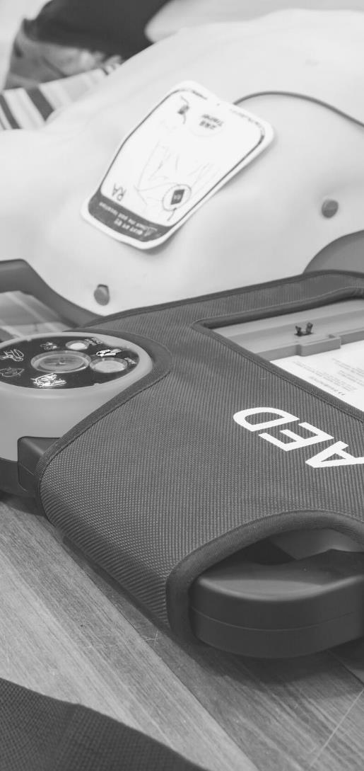
JOHN FURST
FIRSTAIDPOWERPOINT.ORG
Burn Injuries

Slide 2
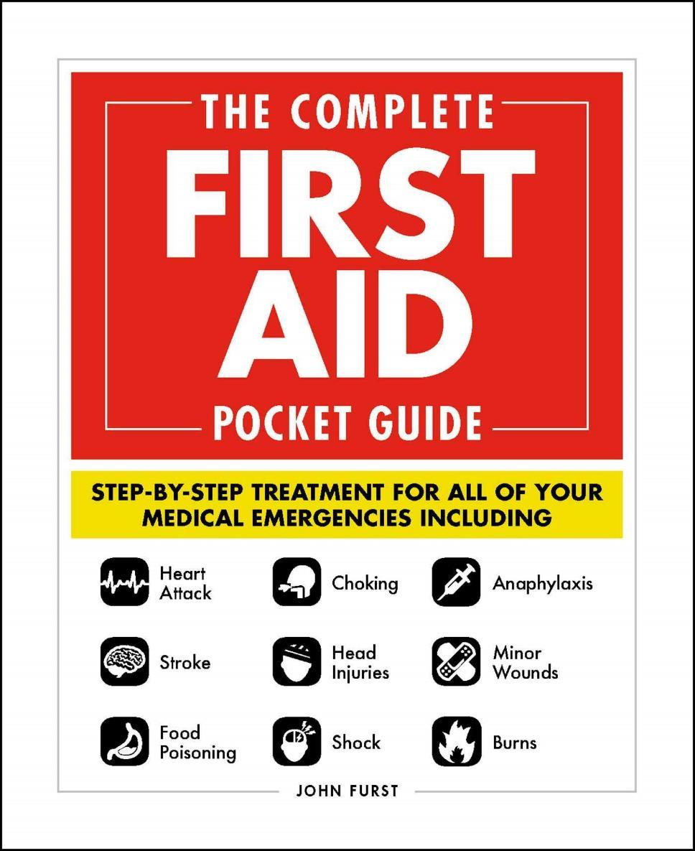

JOHN FURST
FIRSTAIDPOWERPOINT.ORG
From minor cuts and burns, to heart attacks and strokes, this handy, take-anywhere guide gives you the knowledge and advice you need to recognize and respond to any medical emergency.
Be prepared for any medical emergency and handle it safely and efficiently with The Complete First Aid Pocket Guide. Quickly identify signs and symptoms of a wide range of medical conditions and learn how to recognize the difference between a minor injury or illness, and those that are more serious with this essential handbook.

Slide 3
Types of Burn
Burn injuries can be classified by their type and their depth. The main types of burn are:
Scald – caused by a hot liquid or steam
Friction – caused by rough surfaces, e.g: carpet
Radiation/sunburn
Electrical – may have an entry burn and an exit burn
Chemical
Dry – touching hot objects, e.g: a cooker.
FIRSTAIDPOWERPOINT.ORG

Slide 4
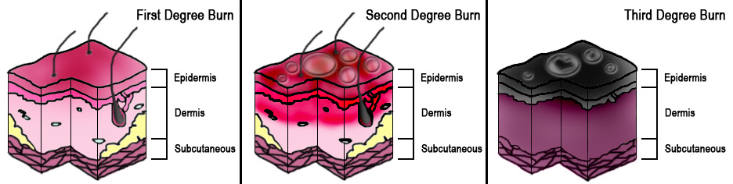
Depths of Burn
Broadly, burns can be classified into three main depths
FIRSTAIDPOWERPOINT.ORG

Slide 5
Depths of Burns
1st degree / superficial: Minor damage to the top layer of skin. Normally appears as just redness. Sunburn is the most common example of a superficial burn
2nd degree / partial: Damage to several layers of skin. Causes blistering of the skin.
3rd degree / full: Damage to skin and underlying tissue. May be charring of the skin.
Large burns may have several depths. For example, there may be a 3rd degree burn surrounded by areas of 2nd and 1st degree burns.
FIRSTAIDPOWERPOINT.ORG

Slide 6
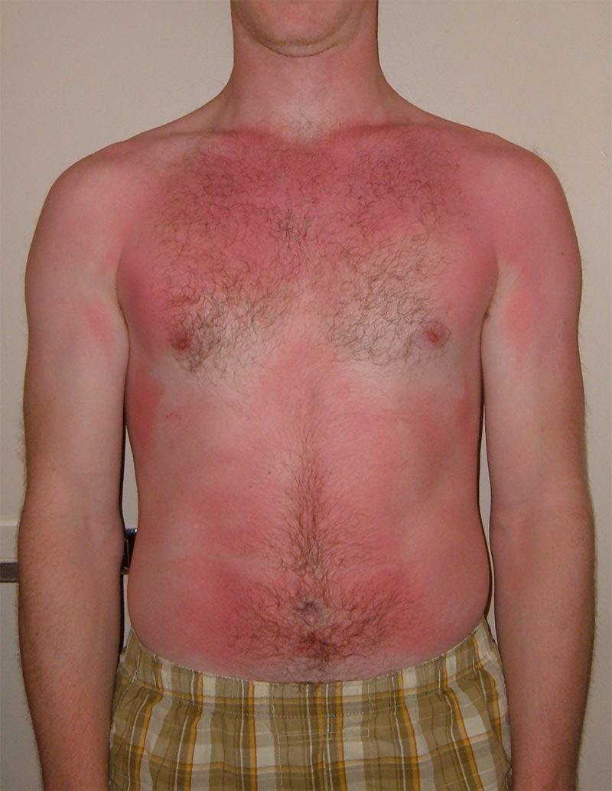
1st Degree / Superficial Burn
FIRSTAIDPOWERPOINT.ORG

Slide 7
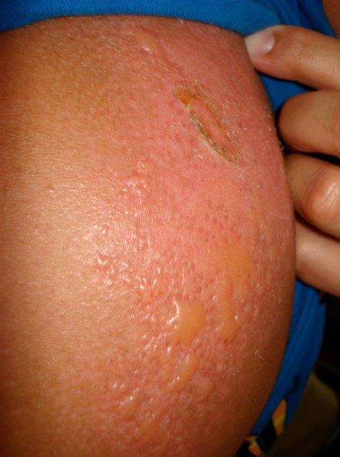
2nd Degree / Partial Thickness Burn
Blister formation
FIRSTAIDPOWERPOINT.ORG

Slide 8
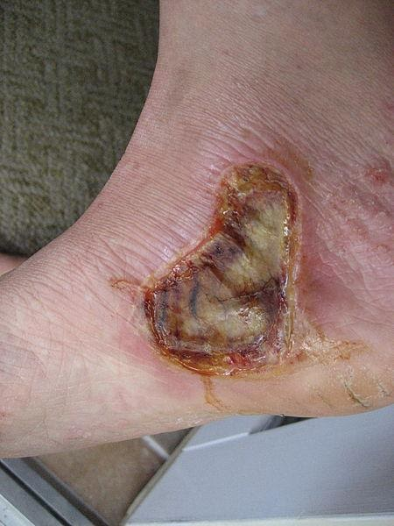
3rd Degree / Full Thickness Burn
FIRSTAIDPOWERPOINT.ORG

Slide 9
First Aid Management
Ensure the scene is safe for you to approach. Call for emergency medical help.
Cool the burn for a minimum of 20 minutes with running water
  If no running water is available, improvise with any cool non-toxic liquid available
Keep the patient warm and prevent hypothermia.
  “Cool the burn, warm the victim”
Cover the burn injury with a sterile non-fluffy dressing or clingfilm. Do not wrap the dressing tight around the burn injury
Do not apply butter or toothpaste to the burn
Do not burst any blisters
Do not remove any clothing stuck to the burn
Do not apply ice to cool the burn
FIRSTAIDPOWERPOINT.ORG

Slide 10
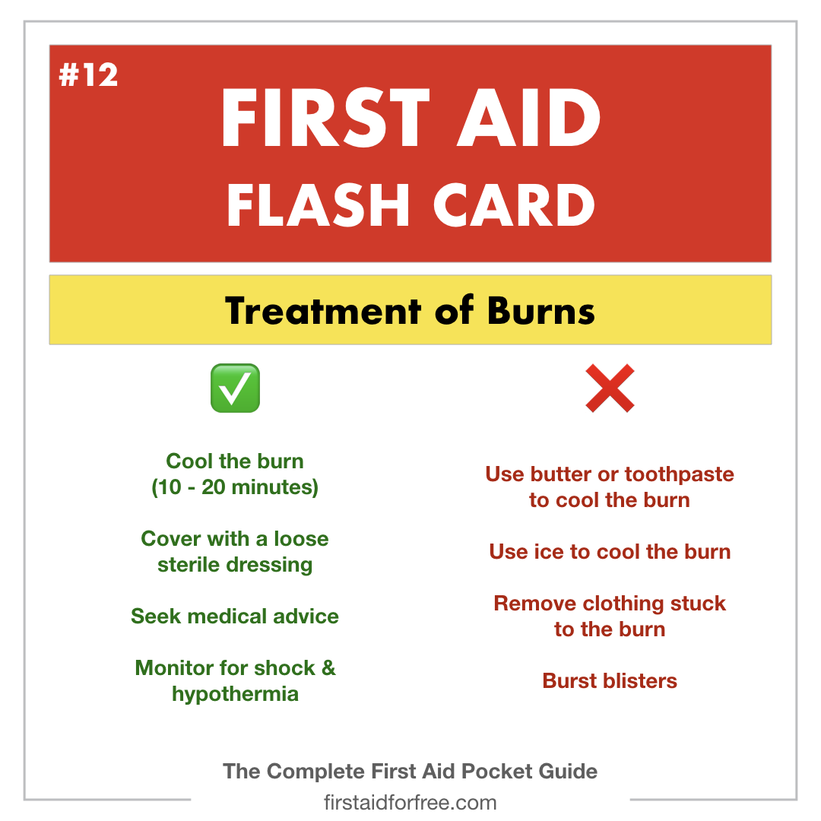
First Aid Management
FIRSTAIDPOWERPOINT.ORG

