Slide 1
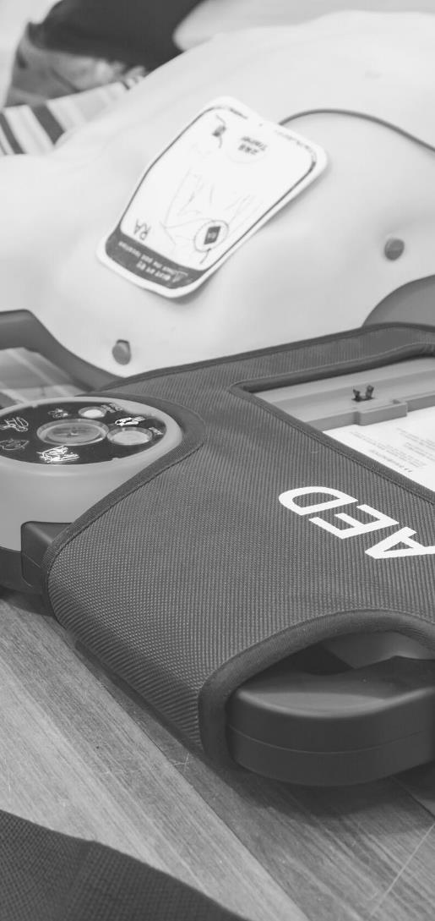
JOHN FURST
FIRSTAIDPOWERPOINT.ORG
Fractures
(Broken Bones)

Slide 2
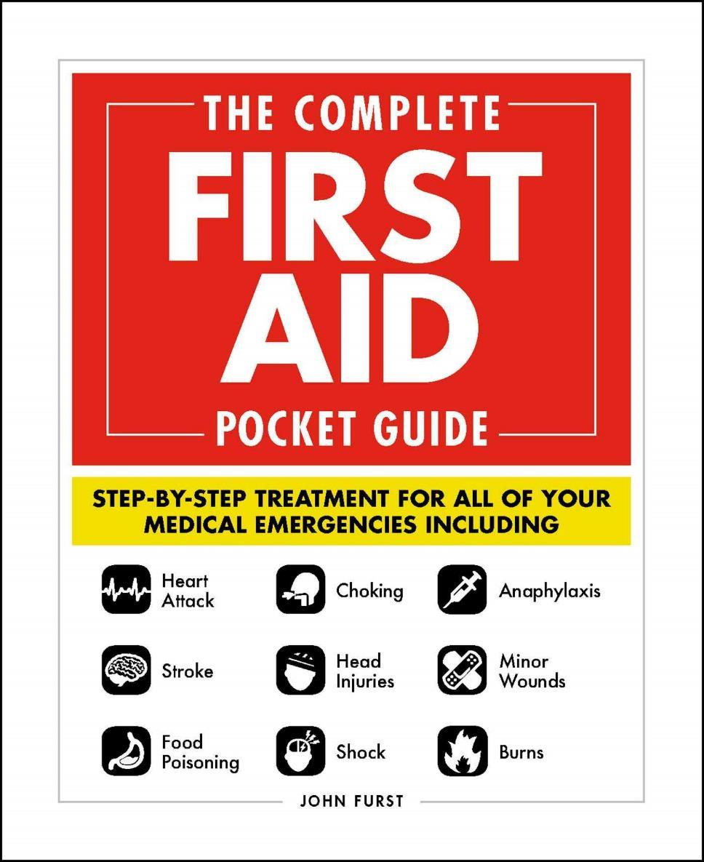

JOHN FURST
FIRSTAIDPOWERPOINT.ORG
From minor cuts and burns, to heart attacks and strokes, this handy, take-anywhere guide gives you the knowledge and advice you need to recognize and respond to any medical emergency.
Be prepared for any medical emergency and handle it safely and efficiently with The Complete First Aid Pocket Guide. Quickly identify signs and symptoms of a wide range of medical conditions and learn how to recognize the difference between a minor injury or illness, and those that are more serious with this essential handbook.

Slide 3
Introduction
A fracture is any break (or combination of breaks) in the continuity of a bone.
Fractures can be open (any fracture associated with a break in the skin), or closed (no break in the skin).
A fracture is the same thing as a broken bone. However, there are many different types of fractures. Knowledge of these types is not required in first aid.
Complications of fractures include bleeding & shock, permanent nerve damage, loss of function of a limb and severe pain. Multiple fractures, especially of long bones, can be life-threatening.
FIRSTAIDPOWERPOINT.ORG

Slide 4
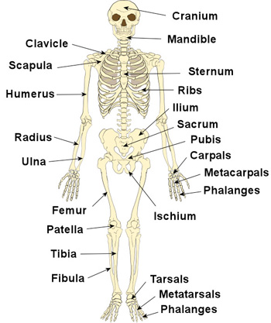
The Skeleton
FIRSTAIDPOWERPOINT.ORG

Slide 5
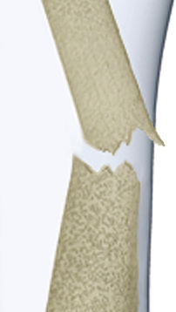
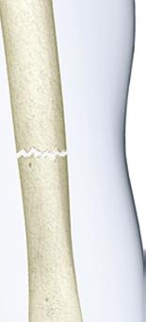
Open vs Closed
Open
Closed
Wound
FIRSTAIDPOWERPOINT.ORG

Slide 6
Signs and Symptoms
Signs and symptoms of a fracture include:
Deformity
Swelling
Bruising
Pain and tenderness
Limited movement
Shock
A protruding bone or open wound
Noise (crepitus)
Inability to weight bear or move limb
Minor fractures may have minimal symptoms.
These fractures are easily mistaken for a sprain or a strain.
FIRSTAIDPOWERPOINT.ORG

Slide 7
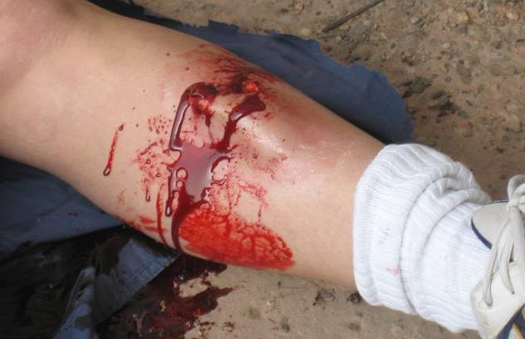
Photo Example – open fracture
Open fractures are at high risk of infection. Germs can infect the exposed bone.
FIRSTAIDPOWERPOINT.ORG

Slide 8
First Aid Management
Carefully expose and examine the site of injury
  Look for evidence of an open fracture or open wound
Remove any constricting clothing or jewellery
Treat any wounds and stop any bleeding
Avoid pressing directly over a fracture site
Immobilize as appropriate to the injury and consider when the next stage of care will be available
Check for movement, sensation and circulation beyond the fracture site, both before and after treatment
Monitor vital signs (if trained) and watch for the development of shock
The exact method of immobilization will depend on the location of the fracture
FIRSTAIDPOWERPOINT.ORG

Slide 9
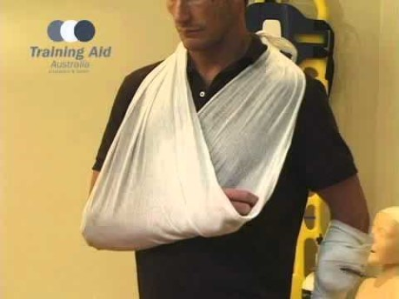
Video – Arm Slings
FIRSTAIDPOWERPOINT.ORG

Slide 10
First Aid for a Lower Limb Fracture
The bones of the leg can be broken by impact, twisting or direct blows. Knees are commonly injured in sporting accidents and falls.
The femur or thighbone is the strongest bone in the body and it takes considerable force to fracture it along its length (although a fracture of the neck of the femur within the hip joint is quite common and discussed in a separate first aid blog post).
This most often occurs after a fall from a great height or a severe impact such as a car accident.
There are two bones in the lower leg, the tibia and the fibula. The tibia is most often broken by a heavy blow, sometimes producing an open wound. The fibula is thinner and can be broken by the kind of twisting that may cause a sprained ankle.
FIRSTAIDPOWERPOINT.ORG

Slide 11
First Aid for a Lower Limb Fracture
Immobilise the legs, using the uninjured leg to splint the broken one.
Bring the uninjured leg to the side of the injured one.
Slide bandages under both legs at the ankles and knees, and above and below the suspected fracture site.
Place padding between the lower legs for comfort.
Roll bandage in a figure of eight around the feet and ankles.
Tie the bandages with the knots on the uninjured side, but stop if this causes pain.
If there is a possible fracture near the ankle then wrap one bandage around the feet and a separate one around the legs just above the ankle instead of using a figure of eight.
FIRSTAIDPOWERPOINT.ORG

Slide 12
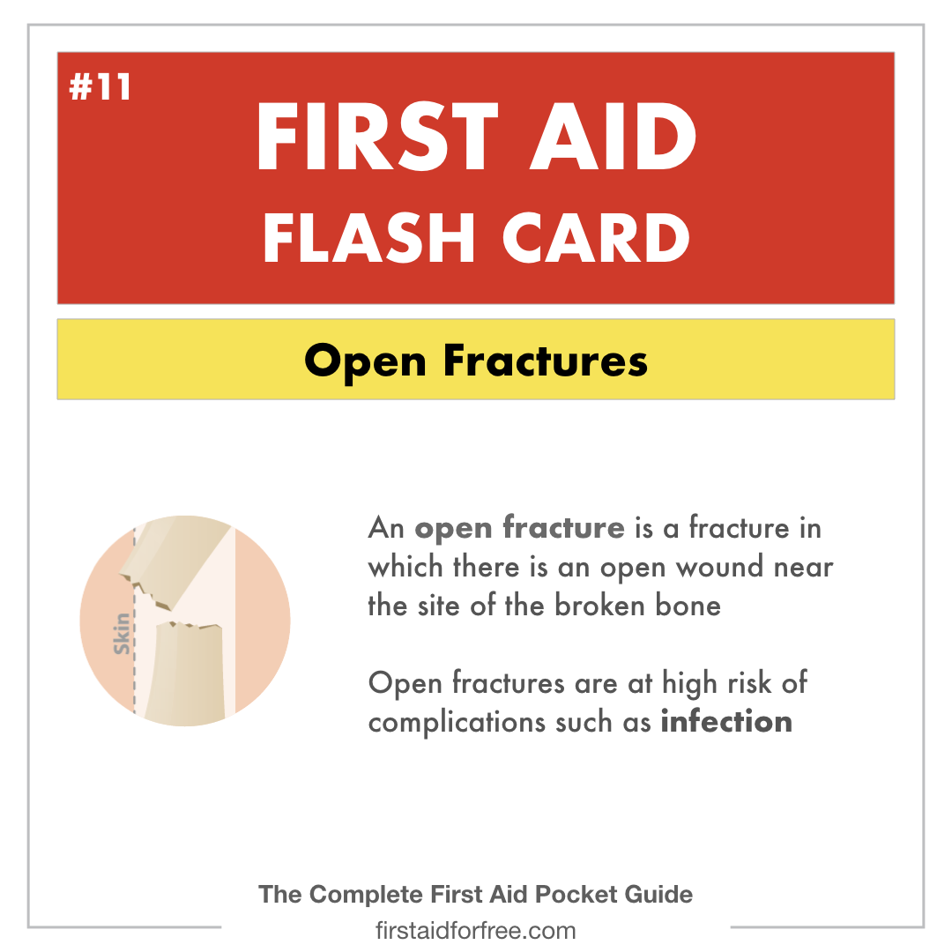
First Aid Flashcard – Open Fractures
FIRSTAIDPOWERPOINT.ORG

