Slide 1
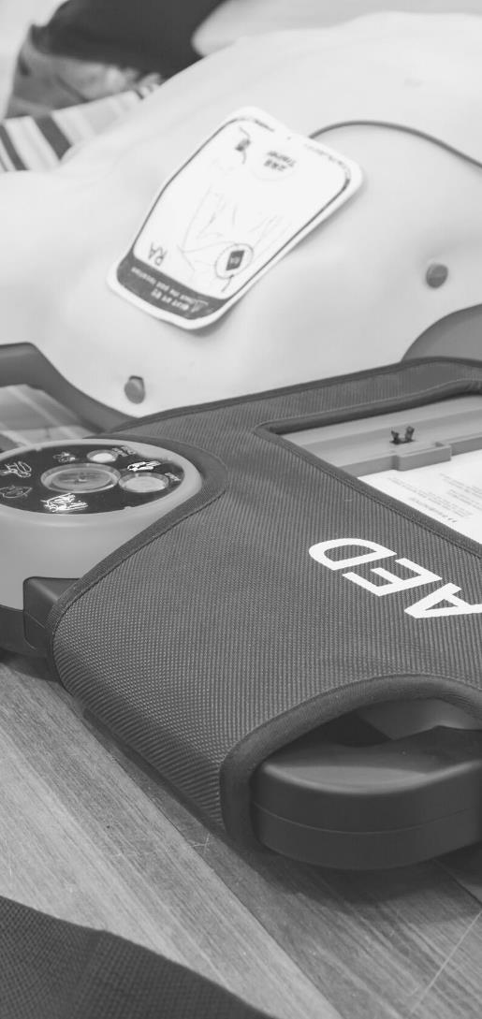
JOHN FURST
FIRSTAIDPOWERPOINT.ORG
Head Injuries

Slide 2
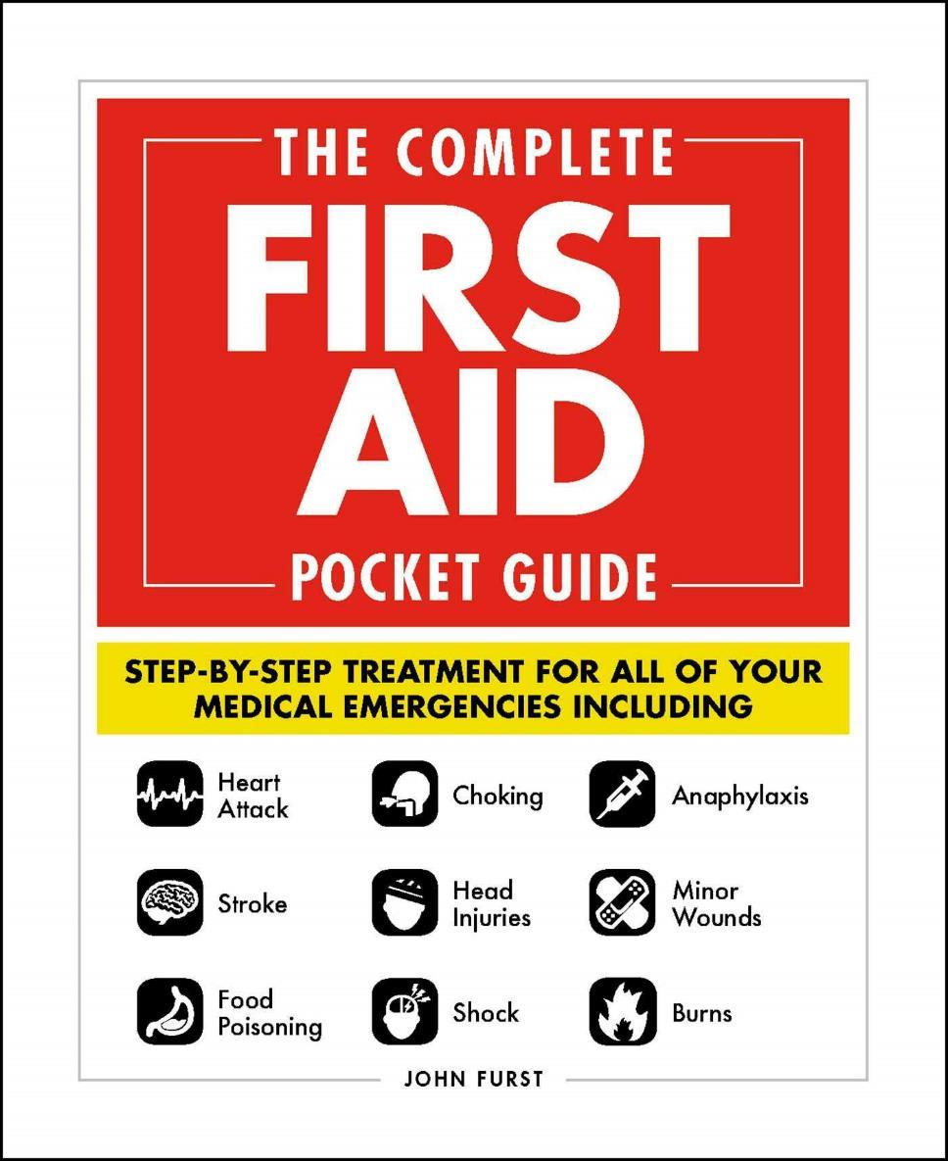

JOHN FURST
FIRSTAIDPOWERPOINT.ORG
From minor cuts and burns, to heart attacks and strokes, this handy, take-anywhere guide gives you the knowledge and advice you need to recognize and respond to any medical emergency.
Be prepared for any medical emergency and handle it safely and efficiently with The Complete First Aid Pocket Guide. Quickly identify signs and symptoms of a wide range of medical conditions and learn how to recognize the difference between a minor injury or illness, and those that are more serious with this essential handbook.

Slide 3
Introduction
Head injuries are a major cause of death and disability worldwide. Serious head injuries can be immediately life-threatening.
A head injury can have long term consequences for the patient. They may survive the initial injury, but be left with permanent disability or personality changes.
Prevention of head injuries is vital. Simple safety measures such as wearing cycle helmets and vehicle seatbelts save lives.
FIRSTAIDPOWERPOINT.ORG

Slide 4
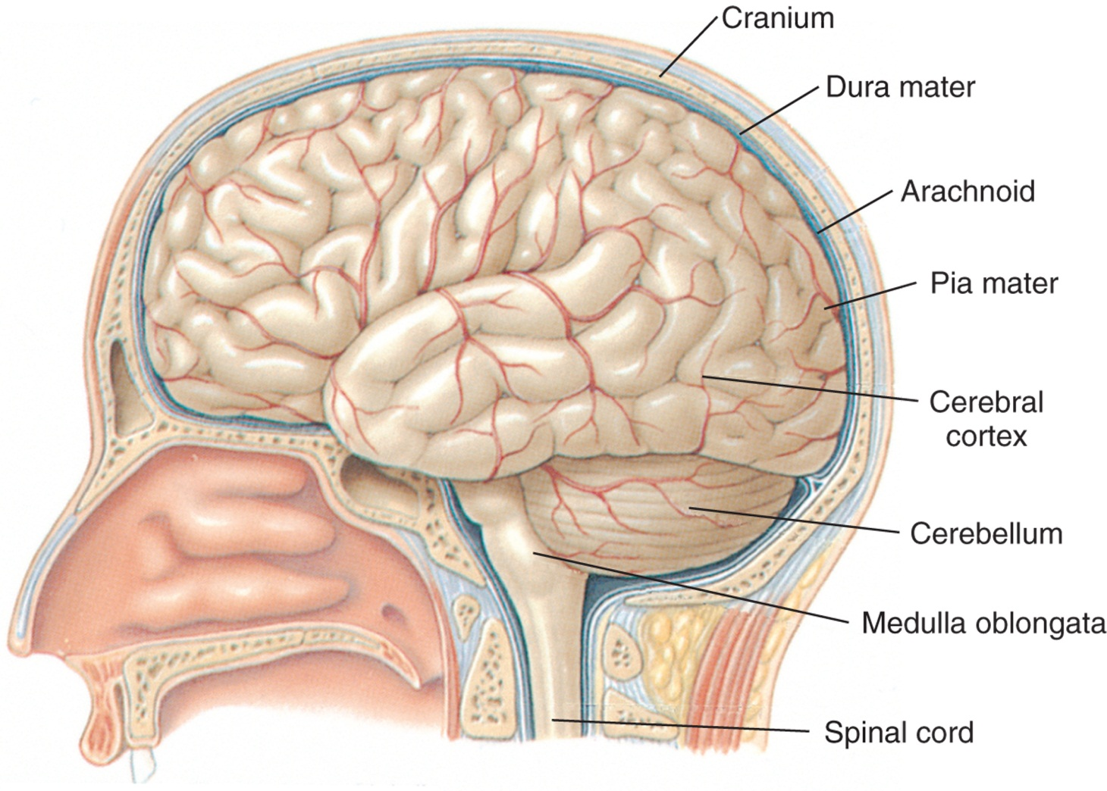
The Skull
FIRSTAIDPOWERPOINT.ORG

Slide 5
The Skull
The skull protects the delicate brain tissue. It is essentially a ‘closed box’, so any swelling or bleeding inside the skull can cause a life-threatening rise in pressure. The contents of the skull are the brain, cerebral spinal fluid (CSF) and blood vessels.
The brain is covered by meninges. These are covers that protect the brain and provide nutrients. The three layers are the dura mater (outer), arachnoid mater and pia mater (inner).
Cerebrospinal fluid (CSF) bathes the brain and spinal cord.
FIRSTAIDPOWERPOINT.ORG

Slide 6
Types of Head Injury
Depending on the mechanism of injury, the patient can suffer various different types of head injury. More than one type of injury can occur in a single patient.
Concussion
Cerebral compression
Skull fracture
Head wound / laceration
FIRSTAIDPOWERPOINT.ORG

Slide 7
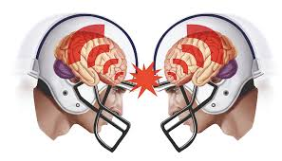
Concussion
Concussion is caused by ‘shaking’ of the brain inside the skull. This is a common injury during contact sports (e.g: football).
Signs and Symptoms
Brief period of reduced consciousness followed by recovery
Dizziness
Nausea
Headache
FIRSTAIDPOWERPOINT.ORG

Slide 8
Cerebral Compression
Cerebral compression is a life-threatening situation that occurs when the pressure inside the skull rises. This puts pressure on the delicate brain tissue (hence the name, compression). Emergency surgery is required in order to relieve the pressure in the skull
Signs and Symptoms
Reduced / deteriorating level of consciousness
History of recent head injury (symptoms may be delayed)
Worsening headache
Noisy breathing
Weakness down one side of the body
Loss of vision
Unequal pupil size
FIRSTAIDPOWERPOINT.ORG

Slide 9
Skull Fracture
The skull is made up of bones. These bones can break resulting in a skull fracture. This is a serious injury requiring early medical intervention. Skull fractures can be closed, open, depressed or affect the ‘base’ of the skull.
Signs and Symptoms
Obvious injury to skull with bleeding
‘Boggy’ swelling to scalp
Bleeding from the ear or nose
Bruising behind the ears or underneath the eyes
History of head injury
Symptoms of concussion or compression may also be present
FIRSTAIDPOWERPOINT.ORG

Slide 10
Head Wound
The scalp is supplied by many blood vessels. As a result, even a small wound can cause significant bleeding from the head. Head wounds require prompt first aid management to stop the bleeding. An underlying brain injury (concussion/compression) may also be present.
Signs and Symptoms
Bleeding from the head
History of head trauma
FIRSTAIDPOWERPOINT.ORG

Slide 11
First Aid Management of Head Injuries
If the victim is unconscious, check for normal breathing. If there is no normal breathing, immediately commence CPR and call for emergency medical help.
Assess the situation and mechanism of injury
Stop any bleeding by applying direct pressure to the wound
For serious head injuries, keep the patient as still as possible and reduce movement of their neck
Call for emergency medical help for all serious head injuries
Monitor vital signs (if trained), pupils and level of consciousness (AVPU or GCS)
Check for other traumatic injuries
If the patient is taking medication to thin the blood, they must always seek medical attention even for minor head injuries
FIRSTAIDPOWERPOINT.ORG

Slide 12
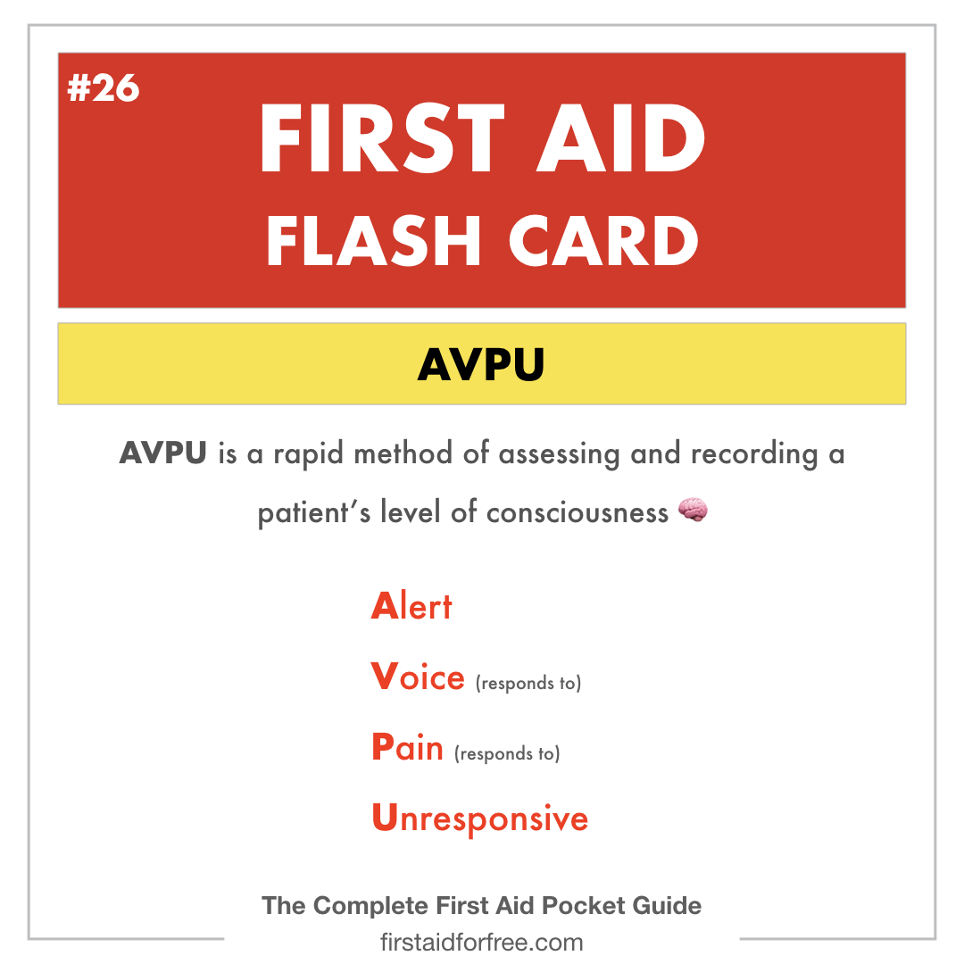
AVPU
FIRSTAIDPOWERPOINT.ORG

Slide 13
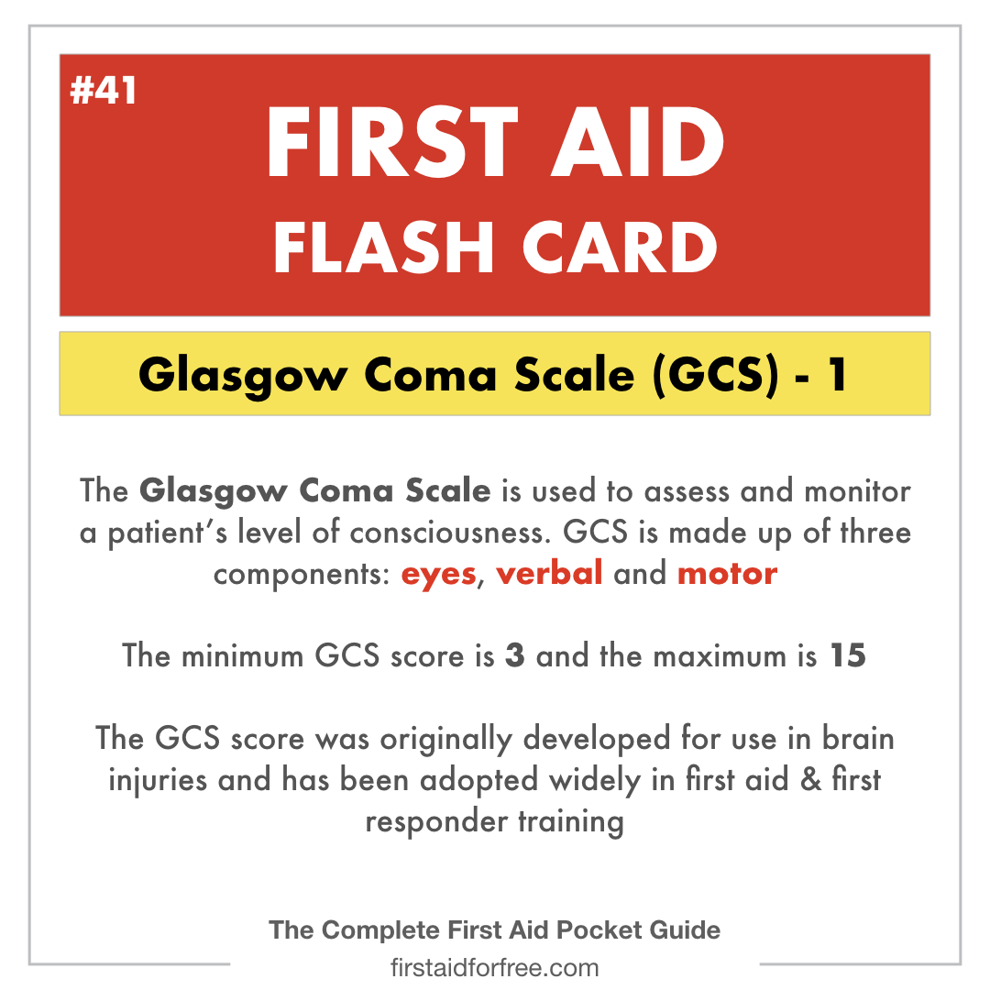
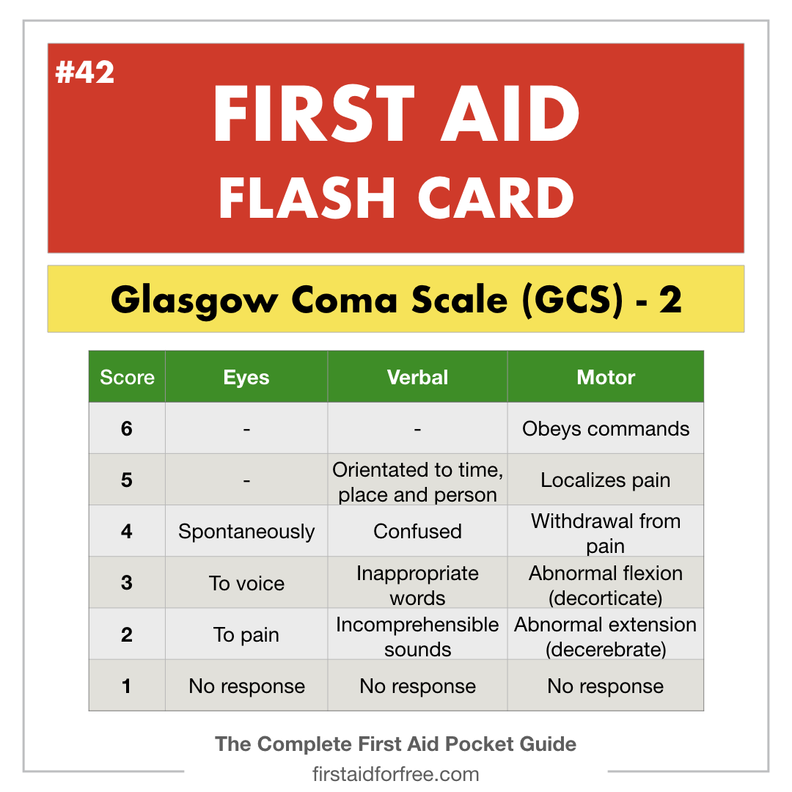
Glasgow Coma Scale (GCS)
FIRSTAIDPOWERPOINT.ORG

